Slide 1
Permitting under laws administered by the DEP’s Land Bureau
Bob Green, Beth Callahan, and Laura Paye
Bureau of Land Resources

Slide 2

Natural Resources Protection Act (NRPA)
Permit required for certain activities and permanent structures in, on, over, adjacent to certain resources
  Many exemptions, other special provisions
38 M.R.S. §480-D standards (existing uses, habitat, etc.)
Ch. 310 Wetlands and Waterbodies Protection Rules
  Avoid and minimize (alternatives analysis), compensate
  Additional restrictions and compensation for WOSS
  “No unreasonable impact” (benefits vs. harm)
Ch. 335 Significant Wildlife Habitat Rules
  Avoid, minimize, compensate, no unreasonable impact
Ch. 315 Scenic and Aesthetic Uses
The NRPA has the greatest regulatory overlap with ACOE permitting
MAINE DEPARTMENT OF ENVIRONMENTAL PROTECTION www.maine.gov/dep

Slide 3
NRPA Standards
1. Existing uses. The activity will not unreasonably interfere with existing scenic, aesthetic, recreational or navigational uses.
2. Soil erosion. The activity will not cause unreasonable erosion of soil or sediment nor unreasonably inhibit the natural transfer of soil from the terrestrial to the marine or freshwater environment.
3. Harm to habitats; fisheries. The activity will not unreasonably harm any significant wildlife habitat, freshwater wetland plant habitat, threatened or endangered plant habitat, aquatic or adjacent upland habitat, travel corridor, freshwater, estuarine or marine fisheries or other aquatic life.
4. Interfere with natural water flow. The activity will not unreasonably interfere with the natural flow of any surface or subsurface waters.
5. Lower water quality. The activity will not violate any state water quality law, including those governing the classification of the State's waters.
MAINE DEPARTMENT OF ENVIRONMENTAL PROTECTION www.maine.gov/dep

Slide 4
NRPA Standards (cont.)
6. Flooding. The activity will not unreasonably cause or increase the flooding of the alteration area or adjacent properties.
7. Sand or gravel supply. For activity is on or adjacent to a sand dune
8. Outstanding river segments. For crossing of any outstanding river segment.
9. Dredging.
10. Significant groundwater well. Demonstrate that the activity will not have an undue unreasonable effect on waters of the State.
11. Offshore wind power project.
MAINE DEPARTMENT OF ENVIRONMENTAL PROTECTION www.maine.gov/dep

Slide 5
Additional Land Use Permitting Activities
Stormwater Management
Site Location of Development
Wind and Solar Energy Development
Shoreland Zoning
Mining
Hydropower
MAINE DEPARTMENT OF ENVIRONMENTAL PROTECTION www.maine.gov/dep

Slide 6
Stormwater Law
Permit required for project disturbing >1 acre
  Exemptions for single-family, detached residences and more
38 M.R.S. §420-D and DEP Ch. 500 rules
  Erosion and sedimentation control
  Pollutant treatment and mitigation of increased frequency and duration of stormwater runoff from property
MAINE DEPARTMENT OF ENVIRONMENTAL PROTECTION www.maine.gov/dep

Slide 7
Site Location of Development Act (Site Law)
Permit required for 3 acres of impervious area, 20 acres of total area, subdivision, OSW 3+ MW, OSW terminal
38 M.R.S. §484 standards (no adverse effect on the natural environment, stormwater, groundwater, etc.)
Ch. 375 No Adverse Environmental Effect Standards
  Unusual natural areas, wildlife and fisheries habitat
  Noise (separate standards for wind energy)
  Scenic (separate standards for wind energy & OSW terminals)
MAINE DEPARTMENT OF ENVIRONMENTAL PROTECTION www.maine.gov/dep

Slide 8
Decommissioning
Decommissioning plan with financial assurance required for grid-scale wind energy development (DEP Ch. 382 rules), solar energy development of 3+ acres (35-A M.R.S. §§ 3491-3497), and battery storage system of 2+ MW (35-A M.R.S. §§ 3498-3499)
MAINE DEPARTMENT OF ENVIRONMENTAL PROTECTION www.maine.gov/dep

Slide 9
Shoreland Zoning
Administered by municipalities; minimum standards established and overseen by DEP/BEP (Ch. 1000)
Establishes allowable uses within 250 feet of lakes, rivers, ocean and certain wetlands and within 75 feet of certain streams
  Ex.) No new dwellings within 100 feet of a lake
MAINE DEPARTMENT OF ENVIRONMENTAL PROTECTION www.maine.gov/dep

Slide 10
Mining
Performance standards for excavations (sand and gravel)
Performance standards for quarries (rocks)
Metallic Mineral Mining Act (new exclusion rule)
MAINE DEPARTMENT OF ENVIRONMENTAL PROTECTION www.maine.gov/dep

Slide 11
Hydropower & Dams
401 Water Quality Certification
Maine Waterway Development and Conservation Act
Maine Water Level Laws
Release from Dam Ownership and Water Level Maintenance
MAINE DEPARTMENT OF ENVIRONMENTAL PROTECTION www.maine.gov/dep

Slide 12
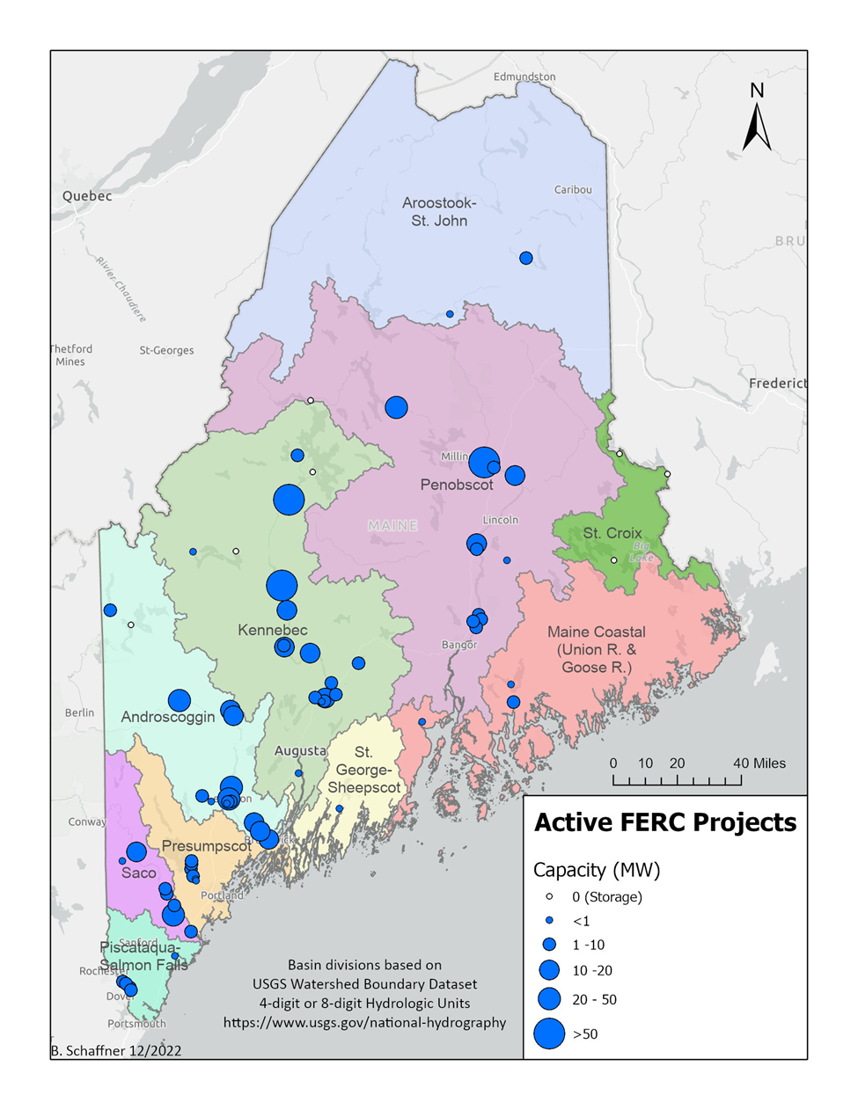
Hydropower in Maine
There are 70 FERC regulated hydropower dams in Maine with a total authorized capacity of ~722 MW
MAINE DEPARTMENT OF ENVIRONMENTAL PROTECTION www.maine.gov/dep
Notes:
There are several other hydropower dams that operate under FERC exemptions, or are not subject to FERC regulation because they pre-date the federal power act

Slide 13
Federal vs. State Process
30 to 50 year terms (default is 40 years)
FERC is required to balance multiple uses
  energy generation/grid stability
  water quality
  fish and wildlife
  recreation
  irrigation (water quantity)
  historic preservation
  tribal/cultural
  environmental justice
FERC must draft an EA or EIS as required by NEPA, and comply with many other laws (e.g. CWA, CZMA, ESA, NHPA, etc.)
Study requests, comments on study results, comments on operations and environmental mitigation measures, etc. all before 401 Cert. application is received
States issue Water Quality Certification (WQC) that can include conditions necessary to ensure attainment of water quality standards
  MUST ACT WITHIN ONE YEAR OF APPLICATION OR AUTHORITY IS WAIVED
for Hydro licensing/relicensing:
  WQC conditions become part of FERC license
  FERC has enforcement authority
MAINE DEPARTMENT OF ENVIRONMENTAL PROTECTION www.maine.gov/dep
Notes:
There are many pieces of the federal process that the State comments on, mainly MDEP, MDMR, MDIFW, MDACF (BPL), and MHPC to represent each agencies respective interests.
During pre-filing, Department provides input into study plan development and implementation of necessary water quality studies
Benthic Macroinvertebrates
Dissolved Oxygen (DO) and Temperature
Trophic State (analysis of chlorophyll content, Secchi disk transparency, etc.)
Habitat assessment
other studies as needed to assess Project’s attainment of State water quality standards (e.g. mercury, fish assemblage, etc.)

Slide 14
Elements of a WQC order
analysis of Project’s attainment (or nonattainment) of water quality standards
  provides summary of study results and presents Department findings for each standard and designated use
  balances multiple (sometimes competing) factors, such as:
    water quality per se (DO, bacteria, chemical pollution, etc.)
    power generation
    process water
    recreation
    habitat and aquatic life (includes fisheries resources)
conditions necessary to attain standards
MAINE DEPARTMENT OF ENVIRONMENTAL PROTECTION www.maine.gov/dep

Slide 15
Activities Requiring a MWDCA Permit
(1) the construction of a new hydropower project, including a new water storage dam, or a new hydroelectric generating facility of any kind, whether utilizing a dam, a natural water feature, natural current velocities, or tidal action;
(2) the reconstruction of a hydropower project;
(3) any dredging or filling below the normal high water line of a water body to facilitate maintenance and repair of an existing and operating hydropower project; and
(4) the structural alteration of a hydropower project in a way that changes water levels or flows above or below the dam, including, but not limited to:
  (a) the addition or alteration of flashboards; and
  (b) the installation of additional or enlarged turbines.
MAINE DEPARTMENT OF ENVIRONMENTAL PROTECTION www.maine.gov/dep

Slide 16
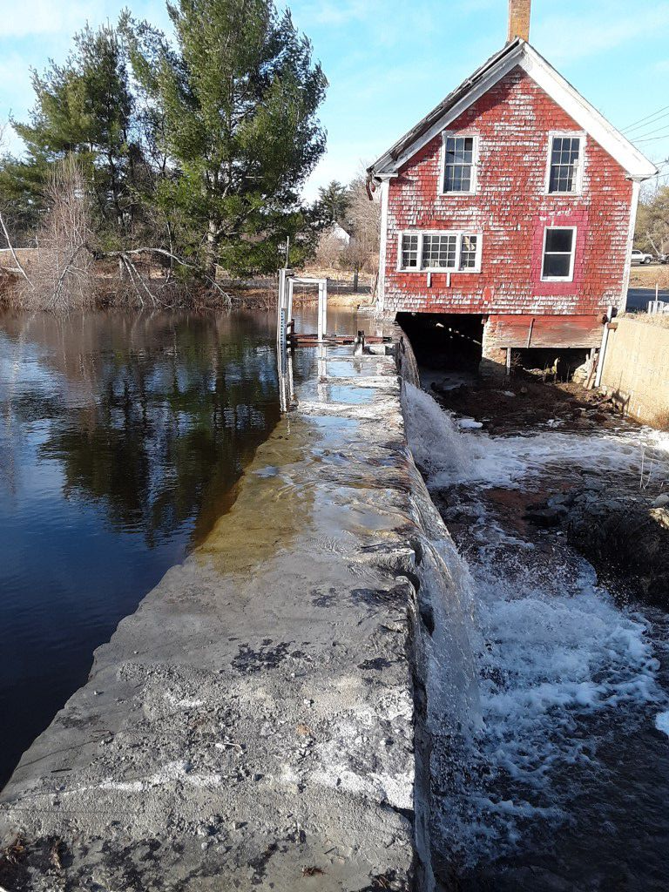
Maine’s Water Level Laws
38 M.R.S. § 840 “The commissioner may on the commissioner's own motion and shall, at the request of the owner, lessee or person in control of a dam, the Commissioner of Inland Fisheries and Wildlife or the Commissioner of Marine Resources, or upon receipt of petitions from the lesser of at least 25% or 50 of the littoral or riparian proprietors or from a water utility having the right to withdraw water from the body of water for which the water level regime is sought, conduct an adjudicatory hearing for the purpose of establishing a water level regime and, if applicable, minimum flow requirements for the body of water impounded by any dam that is not …” a FERC project, operating under another natural resource law, under municipal authority, etc.
MAINE DEPARTMENT OF ENVIRONMENTAL PROTECTION www.maine.gov/dep
Notes:
Another way in which Maine DEP deals with the regulation of aquatic resources is through the water level laws, which allow for either MDIFW, MDMR, MDEP, or 25% or 50 (whichever is less) of riparian owners on a water body that is impounded by a non-hydropower dam (statutory definition) to apply for an adjudicatory hearing for the Department to set a required water level regime on that body of water. There are water level orders at several lakes in Maine, and there is one active water level petition in front of the Department.

Slide 17
Robert.l.green@maine.gov
(207) 615-2214
Laura.Paye@maine.gov
(207) 219-9563

